Slide 1
Guest sign in/up
Cooking classes
Food tours
Links after sign in:
PRODUCTS CHEFS
MANAGE PROUDCTS
LOG OUT
(Host) Sign in
(Host) Sign up
Reviews
etc
Manage a Chef profile
Manage a product
Products - all
Product - detail
Sign in
required
Landing page with links
SIGN IN SIGN UP
“PRODUCTS” CHEFS
No sign in
required
Edit
Delete
Add
Edit
Delete
Chefs - all
Chefs - detail

Slide 2
User :
Firstname:
Last Name:
Email:
Password:
Date of birth:
(street)
(city)
Description:
Profile picture:
Restrictions : * label
Event :
Event_name:
Chef : *user
Menu :{
Starter:
Main:
Dessert:}
Type :[breakfast, brunch,lunch, dinner]
Date:
location:
MaxPeople:
Theme:
Price:
Restrictions :*label
Images :
Guests [users ID,…]
Restriction :
label:
Moment js to formate a date (artist lab)

Slide 3
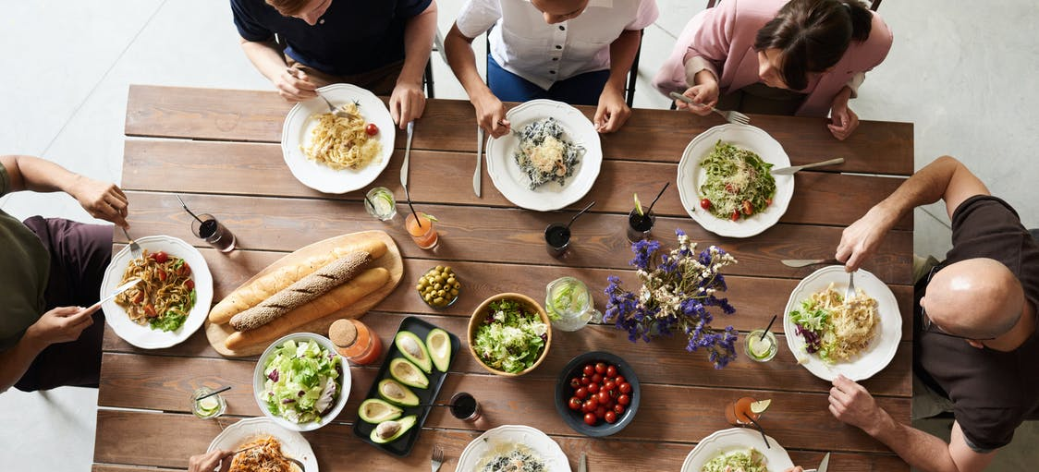
Index.hbs
Signup
Login
TITLE
« in typing » description
See all the events

Slide 4
All-events.hbs
Signup
Login
Description ?
Event_name
Type
Date
Diet
See more..
Event_name
Type
Date
Diet
See more..
Event_name
Type
Date
Diet
See more..
Event_name
Type
Date
Diet
See more..
Event_name
Type
Date
Diet
See more..
Picture of meal
Picture of meal
Picture of meal
Picture of meal
Picture of meal
If time + host profile picture

Slide 5
one-event.hbs
Signup
Login
description
Event :
Event_name:
Date:
Chef :
Menu :
Starter:
Main:
Dessert:
Type :
location:
MaxPeople:
Theme:
Price:
Diet:*tag
Meal
Details about the chef
Join the event
host
place
You need to be logged in

Slide 6
signup.hbs
Firstname:
Last Name:
Email:
Password:
Signup!

Slide 7
loggin.hbs
Email:
Password:
Log me in!
You dont have an account? Signup !

Slide 8
create-event.hbs
My events
My profile
Log-out
Event :
Event_name:
Chef : *user
Menu :{
Starter:
Main:
Dessert:}
Type :[breakfast, brunch,lunch, dinner]
Date:
location:
MaxPeople:
Theme:
Price:
Restrictions :*tag
Images :
Guests [users ID,…]
Create !

Slide 9
Manage-page.hbs
Create an event
My events
My profile
Log-out
As a host
Host one !
Event_name
Type
Date
Diet
See more..
Event_name
Type
Date
Diet
See more..
Cancel
Edit
Cancel
Edit
As a guest
Event_name
Type
Date
Diet
See more..
Cancel

Slide 10
edit-event.hbs
Create an event
My events
My profile
Log-out
Event :
Event_name:
Chef : *user
Menu :{
Starter:
Main:
Dessert:}
Type :[breakfast, brunch,lunch, dinner]
Date:
location:
MaxPeople:
Theme:
Price:
Restrictions :*tag
Images :
Guests [users ID,…]
update !

Slide 11
Edit-profile.hbs
Create an event
My events
My profile
Log-out
User
User :
Firstname:
Last Name:
Email:
Date of birth:
(street)
(city)
Description:
Restrictions : * (tag)
Modify picture
Update my profile !

Slide 12
One-profile.hbs
Create an event
My events
My profile
Log-out
User
User :
Firstname:
Last Name:
(street)
(city)
About me :
Restrictions : * (tag)

